Slide 1
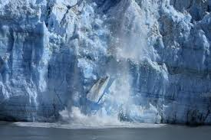
Global warming
One of the down effects of global warming is that it causes ice glaciers to melt and which leads to a rise in sea level. Not forgetting that 60% of the Earth is occupied by water.

Slide 2
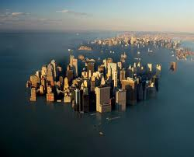
A increase in glaciers meting could result in the large part of earth being sworn up in water.
These could take place in the future if we do not our carbon emissions' and burning of other green house gases that affects the environment.

Slide 3
Ways in which we can reduce carbon emission.
The are many ways in which we can reduce our carbon footprint in our households that does not take to much effort. Such as unplugging appliance that your not using at the moment.

Slide 4
Switching of lights when your not in the room can also play vital role in reducing emissions of greenhouse gases.

Slide 5
The earth hour concept is one such event that encourages people to switch off their

Slide 6
Simple changes
People can make simple change like riding a cycle to shopping unlike driving all the time and taking public transport to work.

Slide 7
Possible solutions.
People can also help mother nature by planting trees because trees convert carbon monoxide to oxygen which people need to survive.

Slide 8
Going green
People can reduce the emission of green house gases by recycling ,plastic, paper ,can and many more .

Slide 9
Government also has to enforce law that promote green economy and heavier tax on pollution so companies can change to more sustainable way of manufacturing.

Slide 10
Planet Earth.
Recycle ,reuse be responsible when using electricity do not do it for me but for the future of planet

